Slide 1

EMBEDDINGS

Slide 2
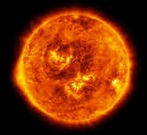

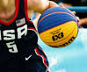
WHAT ARE EMBEDDINGS?
Embeddings are mathematical representations of unstructured information (text, sound, images) that allows objects with similar semantics to have similar representations
e.g. in a good text embedding, words with similar meanings are embedded in similar vectors (contrast this with BoW)
e.g. in a good image embedding, pictures with similar objects are embedded in similar vectors

Slide 3
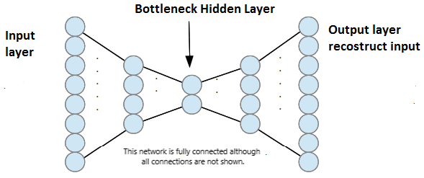
AUTOENCODERS
Unsupervised dimensionality reduction technique
Forces bottleneck layer to encode all information
Good shortcut to encode information is via semantics (meaning)

Slide 4
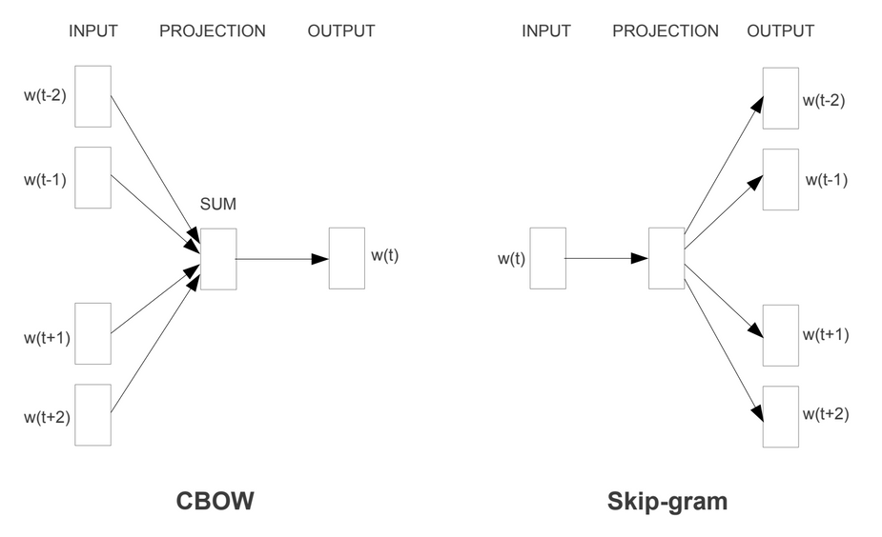
WORD EMBEDDINGS - WORD2VEC
Enriches the notion of autoencoder by considering not only the word but also the words that show up around it
Two versions, depending if it's more important to guess the word based on the context or predict the context based on the word
We have huge corpuses for training, essentially all of literature created so far

Slide 5
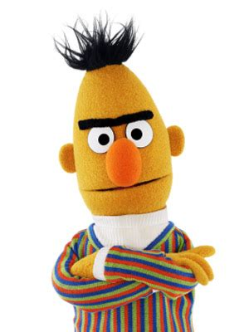
WORD EMBEDDINGS - BERT FAMILY
Word2Vec still associates the same vector to the same word
BERT - Bidirectional Encoder Representations from Transformers consider not only the word but also it's context *during encoding*, which means it can extract different meanings from the same word
"the man robbed a bank" vs "the bank of the river was flooded"

Slide 6
EMBEDDINGS
Pro : can be used pre-trained if your application is generic. For the vast majority of cases the word embeddings trained on Wikipedia are good enough
Pro: can be customized from a pre-learned model at a fraction of the cost. If you have a relatively modest corpus, you can piggyback on a pre trained model that already knows most of the smeantics of english
Con: can be quite difficult to train from scratch. Pretty much only google and a few other large data holders can create these models (queue GPT3)
Con: they are too cool. Food and shelter are also needed but pale in comparison.

